Slide 1

Machine Learning
Reinforcement Learning
Pramote Kuacharoen

Slide 2
What is Reinforcement Learning?
Learning from interaction
Goal-oriented learning
Learning about, from, and while interacting with an external environment
Learning what to do—how to map situations to actions—so as to maximize a numerical reward signal

Slide 3
Reinforcement Learning
Training Info = evaluations (“rewards” / “penalties”)
RL
System
Inputs
Outputs (“actions”)
Objective: get as much reward as possible

Slide 4
Reinforcement Learning
Train decision makers to take actions to maximize rewards in an uncertain environment
Decision makers: software decision makers i.e. programs or agents
Actions: The output of the program is a set of actions, rather than a set of predictions.
The algorithm that determines these actions is called the policy
Those actions must be optimized to earn rewards (and avoid punishments)
Those rewards and punishments are externally imposed by the environment
The environment is complex, so the reward/punishment for actions is usually not known in advance
The decision maker (program) needs to be trained to explore that uncertain environment – combining cautions and courage

Slide 5
Key Features of RL
Agent (Learner) is not told which actions to take
Trial-and-Error search
Possibility of delayed reward (sacrifice short-term gains for greater long-term gains)
The need to explore and exploit
Considers the whole problem of a goal-directed agent interacting with an uncertain environment

Slide 6

Complete Agent
Temporally situated
Continual learning and planning
Object is to affect the environment
Environment is stochastic and uncertain

Slide 7
Notation
S(t), A(t) → R(t+1), S(t+1)
(s, a, r, s')
s’ = state when doing action “a” from state “s”
r = reward when action “a” is performed while in state “s”

Slide 8
Elements of RL
Policy: what to do
Reward: what is good
Value: what is good because it predicts reward
Model: what follows what
Policy
Reward
Value
Model of
environment

Slide 9
Rewards
We define how to give rewards to the agent
If we give same reward no matter what the agent does, the agent will always just behave randomly
Ex. Give your dog a treat when it behaves badly – encourages bad behavior
Be careful not to build your own prior knowledge into the AI
Ex. Chess
Agent should be rewards for wining, not taking opponent’s pieces
No reward for implement strategy you read about in chess book
Free the agent to find its own solution
OK to lose all but one piece and then win
Tell the agent what you want it to achieve, not how you want it to be achieved

Slide 10
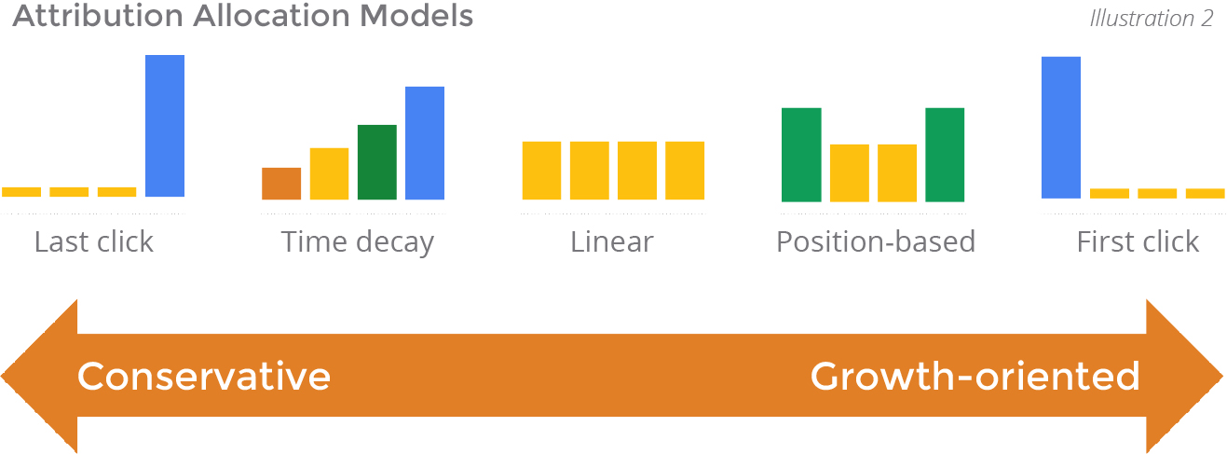
The Value Function
Credit Assignment Problem
What did you do in the past that led to the reward you are receiving now?
What action gets the credit?
Attribution
Related to online advertising concept of attribution
If we show the user the same ad 10 times before they buy, which ad gets the credits?
In RL, we do not just assign ad-hoc like this

Slide 11
The Value Function
Delay Rewards
Delayed rewards: another way of thing of the same thing
Credit assignment: present → past
Delay rewards from the other direction: present → future
Related to field know as “planning”

Slide 12
Scenarios
Scenario 1
2 possible next state from A: B or C
B: reward 1, C: reward 0
50% probability of ending up in either
Reasonable value for A
Value(A) = 0.5x1 + 0.5x0 = 0.5
Scenario 2
1 possible next state from A: B
100% probability for ending up in B
Reasonable value for A?
Value (A) = 1x1 = 1
Value tells us the “future goodness” of a state

Slide 13
Value Function
V(s) – the value (taking into account the probability of all possible future rewards) of a state

Slide 14
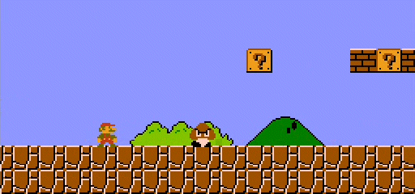
Reward vs. Values
Value is a measure of possible future rewards we may get from being in this state
Reward is immediate
Ex.
Jumping on a Goomba will immediately increase your score
Standing in front of a Goomba will not increase your score, but will put you in a position to jump in the next few states
Standing somewhere not near the Goomba will not give us a change to jump on it
We therefore choose to actions based on values of the states
Reward is the main goal, but needs to consider future rewards

Slide 15
An RL Approach to Tic-Tac-Toe
1. Make a table with one entry per state:
State V(s) – estimated probability of winning
_{.5 ?}
_{x}
_{.5 ?}
Now play lots of games. To pick our moves, look ahead one step:
. . .
. . .
_{x}
_{1 win}
_{x}
_{x}
_{o}
_{o}
. . .
_{0 loss}
_{current state}
_{x}
. . .
_{o}
_{x}
_{o}
_{o}
. . .
. . .
_{various possible}
_{next states}
_{o}
_{o}
_{0 draw}
*
_{x}
_{x}
_{o}
_{x}
_{x}
_{o}
_{o}
Just pick the next state with the highest
estimated prob. of winning — the largest V(s);
a greedy move.
But 10% of the time pick a move at random;
an exploratory move.

Slide 16
Finding V(s)
Iterative Algorithm
Initialize V(s)
V(s) = 1 if s = winning state
V(s) = 0 if s = lose or draw
V(s) = 0.5 otherwise
V(s) can be interpreted as probability of winning after arriving in s (for this game only)

Slide 17
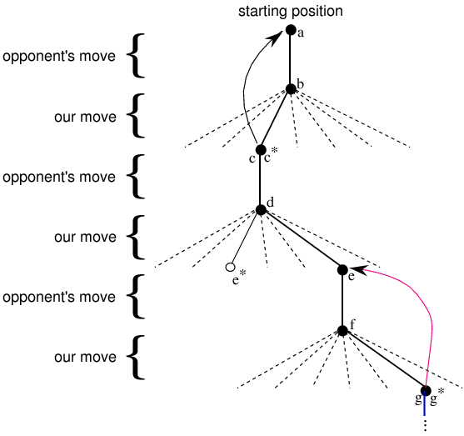
RL Learning Rule for Tic-Tac-Toe
_{“Exploratory” move}

Slide 18
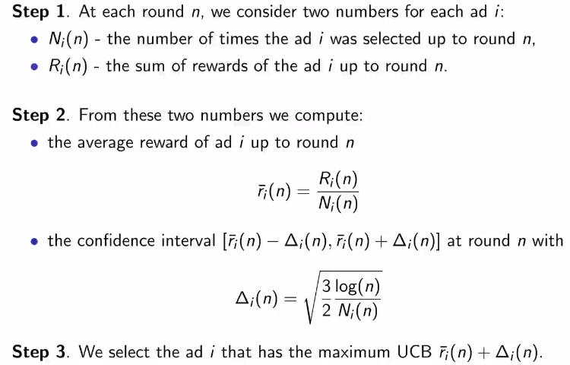
Upper Confident Bound

Slide 19
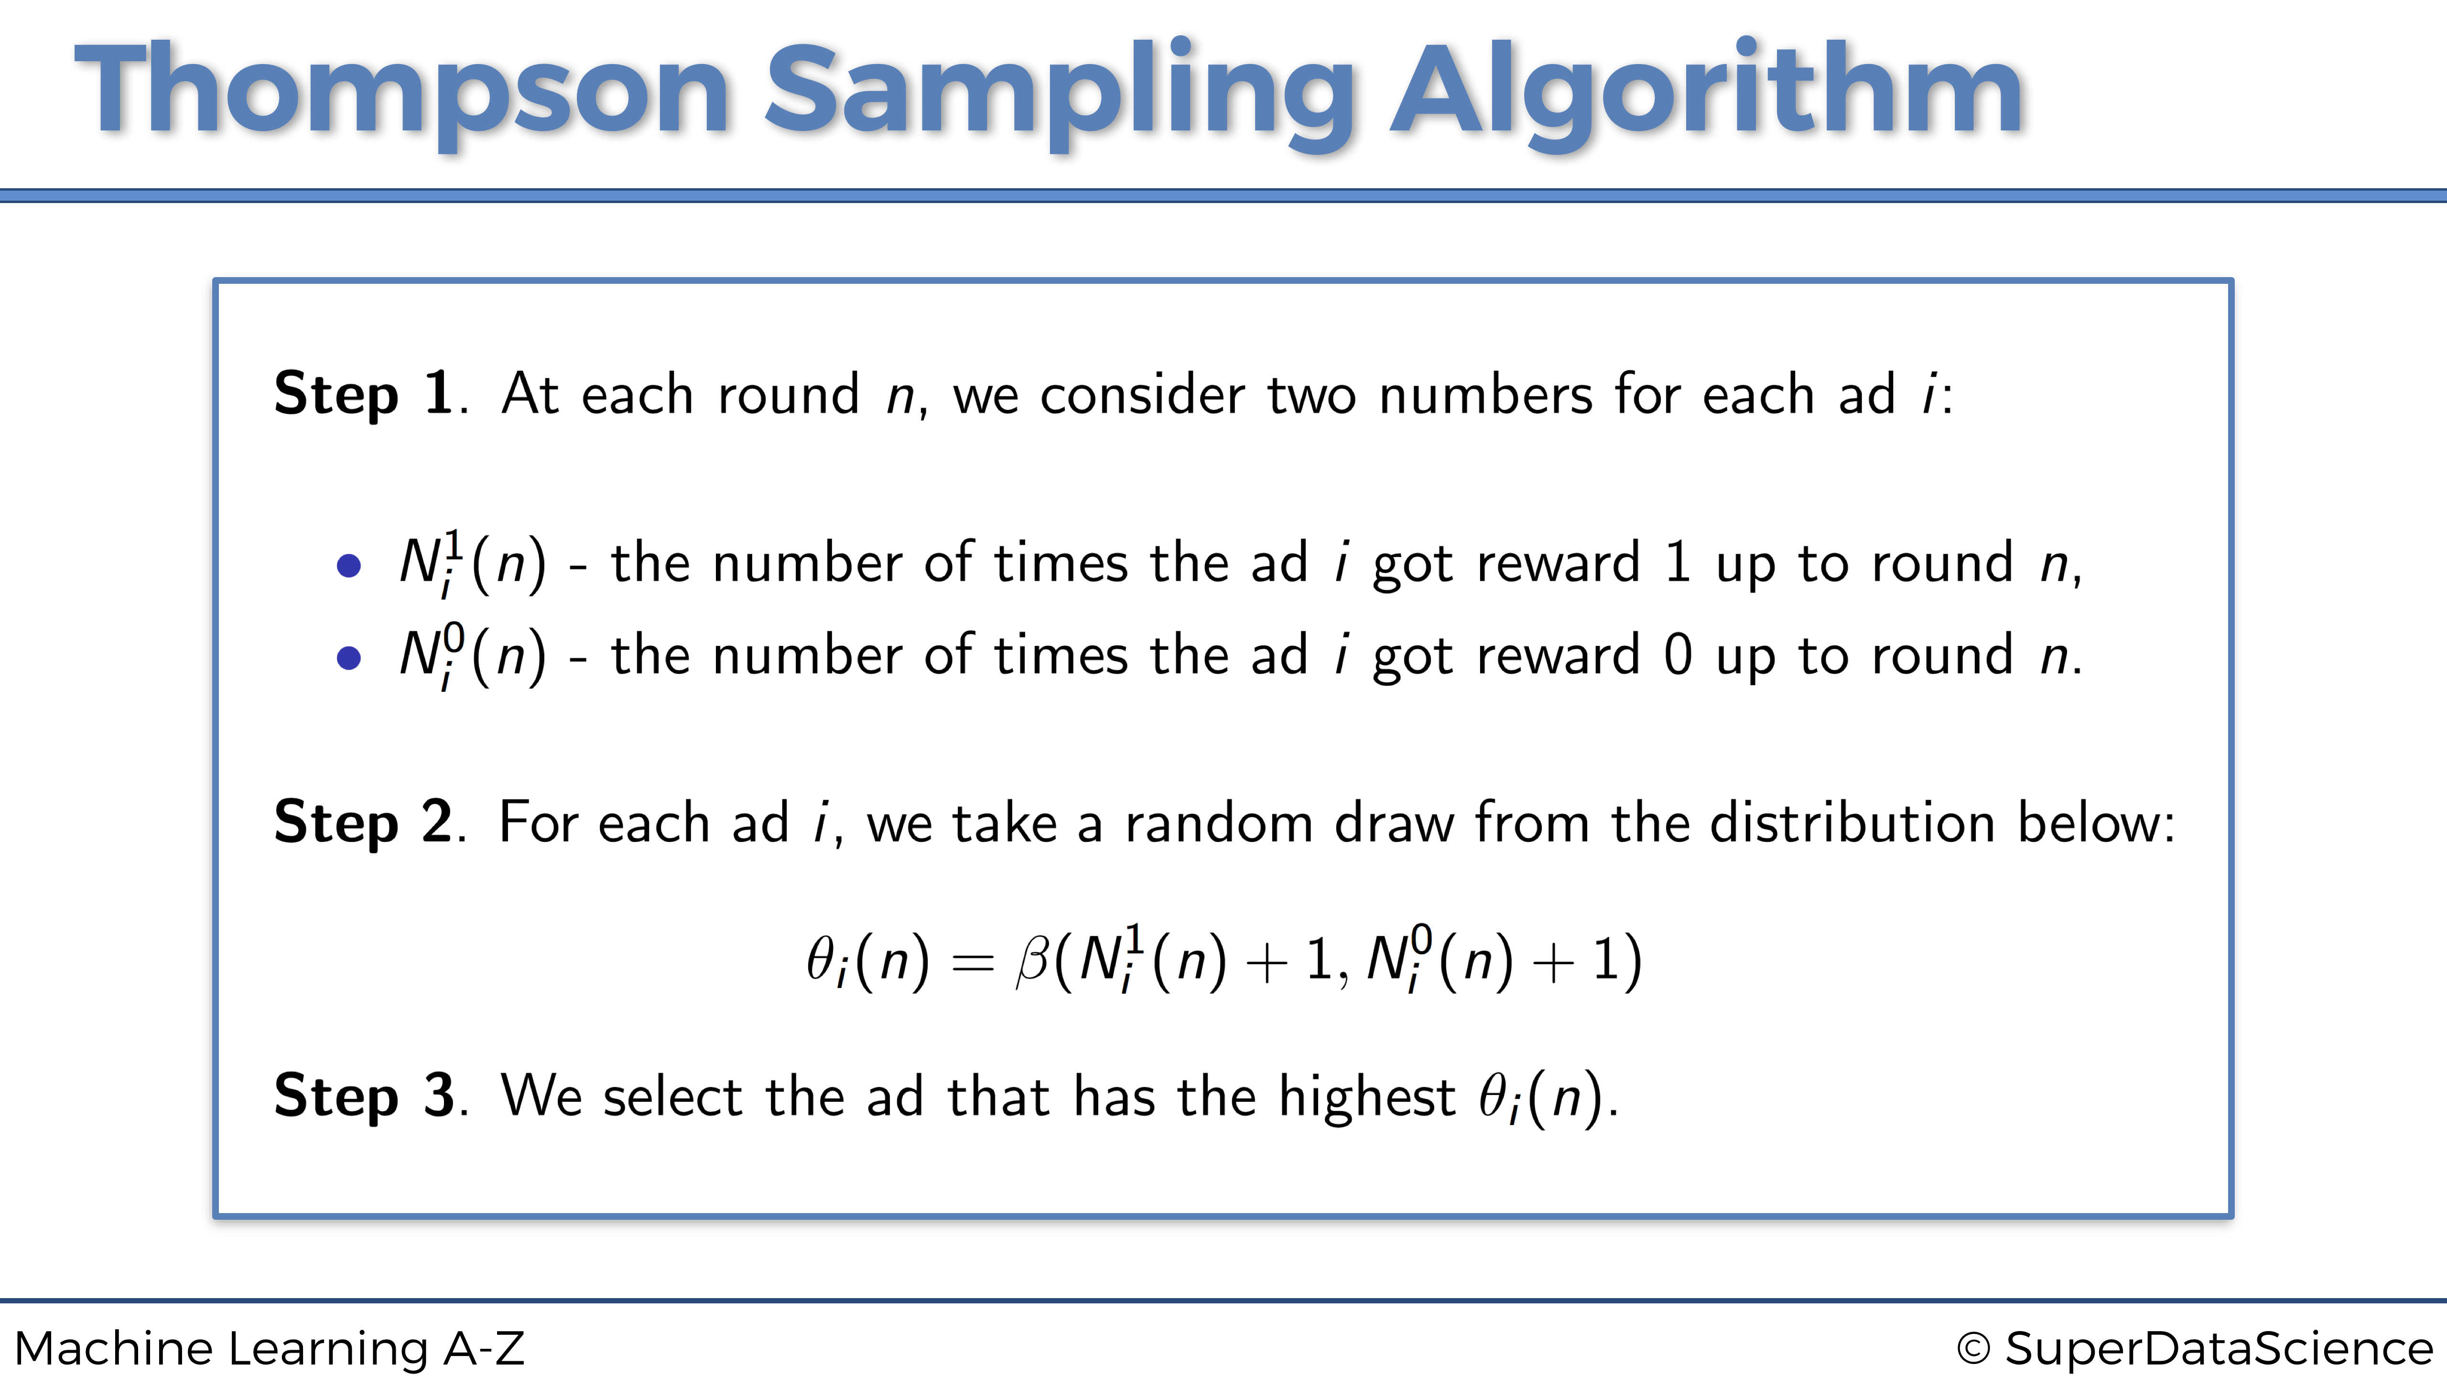

Slide 20
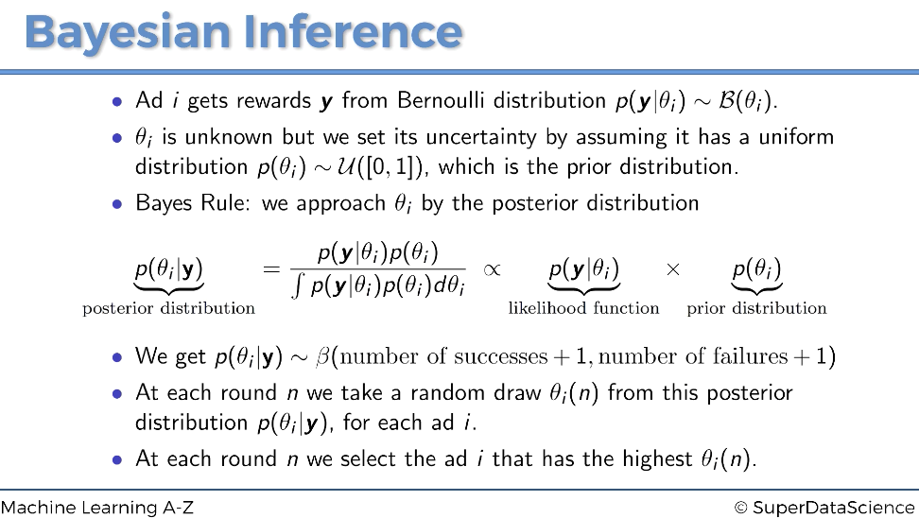

Slide 21
Question?
Insert Image

